Slide 1
Electronic and ionic equilibrium
Fyodor Malchik

Slide 2
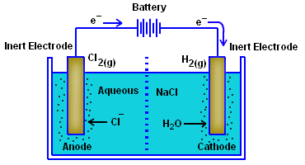
Electrolytes
Substances which can conduct
electricity
in their
aqueous solution due to ionization
are known as in
electrolytes. The presence of ions
solution is
responsible for the conduction and when the current passes through the wires, it shows the movement of free electrons through wire. This process of dissociation and flow of ions in aqueous solution of electrolyte is known as electrolysis.
Example: Electrolysis of sodium chloride in its aqueous solution gives sodium and chloride ion in solution.
3

Slide 3
Examples of Strong Electrolytes
Hydrochloric Acid | (HCl)
Nitric Acid | (HNO₃)
Sulphuric Acid | (H₂SO₄)
Hydro Bromic Acid | (HBr)
Hydro Iodic Acid | (HI)
Per Chloric Acid | (HCIO₄)
Acetic Acid | (CH₃COOH)
Carbonic Acid | (H₂CO₃)
Ammonia | (NH₃)
Lithium Hydroxide | (LiOH)
Sodium Hydroxide | (NaOH)
Potassium Hydroxide | (KOH)
Rubidium Hydroxide | (RbOH)
Cesium Hydroxide | (CsOH)
Calcium Hydroxide | (Ca(OH)₂)
Strontium Hydroxide | (Sr(OH)₂)
Barium Hydroxide | (Ba(OH)₂)

Slide 4
Weak Electrolytes
Electrolytes which are weakly ionized in their aqueous solution are called as weak electrolytes.
In the aqueous solution of weak electrolytes, the constituent ions are in equilibrium with un-dissociated molecules of electrolytes.
This type of equilibrium involving ions in aqueous solution is called ionic equilibrium.
The dissociation of weak electrolyte is represented by ⇌
Example: CH₃COOH + H₂O ⇌ H₃O⁺ + CH₃COO⁻
7

Slide 5
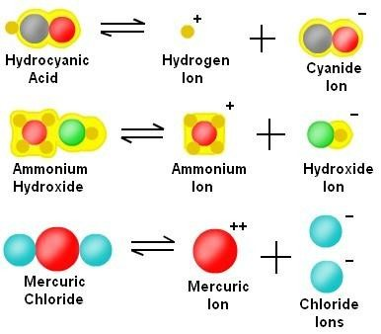
Weak Electrolytes
Such type of equilibrium exists between ions and unionized molecule is called as ionic equilibrium. The fraction of molecules dissociates can be represented by using degree of dissociation.
Generally weak acids and weak bases are good examples of weak
electrolytes.

Slide 6
Degree of Dissociation(α)
The degree of dissociation of an electrolyte is defined as a fraction of total number of moles of the electrolyte that dissociates into its ions when the equilibrium is attained. It is denoted by Alpha (α) and given as:
α = Number of moles dissociated Total number of moles

Slide 7
Non-Electrolytes
Non-electrolytes are the substances which cannot conduct electricity in their aqueous solution due to the absence of ions. They are generally polar or non-polar covalent compounds which can dissolve in water as molecules instead of ions.
As covalent compounds contain covalent bonds bonded atoms, therefore cannot be ionized in their and exists in the form of molecule only.
between solution
Example, Sugar (C₁₂H₂₂O₁₁), alcohols are soluble in water but
remain in molecular form only.
C H O (s)➡C H O (aq)
12 22 11 12 22 11

Slide 8
List of Non-Electrolytes
S.No | Non-electrolyte | Chemical formula
1 | Sucrose | ^{C}12^{H}22^{O}11
2 | Glucose | ^{C}6^{H}12^{O}6
3 | Ethanol | C₃H₃OH
4 | Methanol | CH₃OH
5 | Carbon tetrachloride | CCl₄
6 | Carbon disulphide | CS₂
7 | Kerosene | Hydrocarbons
8 | Chemically pure water | H₂O
9 | Urea | NH₂CONH₂
10 | Dichloromethane | CH₂Cl₂
11 | Glycerol | CH₂OH-CHOH-CH₂OH
12 | Methylsulfonylmethane (MSM) | (CH₃)₂ SO₂
13 | Carbon dioxide | CO₂
14 | Oxygen | O₂
15 | Sulphur dioxide | SO₂

Slide 9
Arrhenius Concept of Acid and Bases
In 1884 the Swedish chemist Svante August Arrhenius (1859-1927) proposed that acids and bases can be defined in terms of the chemical species they form when they dissolve in water.

Slide 10
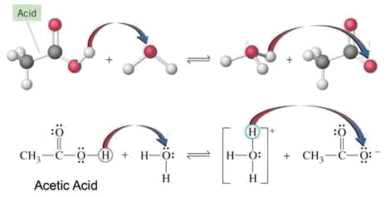
Arrhenius Concept of Acid and Bases
Arrhenius Acid: According to Arrhenius
theory, acid is a
substance which has hydrogen atom and can be given in the form of hydrogen ion in aqueous solution. Such substances are called as Arrhenius acids. For example, when acetic acid (CH₃COOH) dissolves in water, it will form acetate ion (CH₃COO⁻) and hydronium ion (H₃O⁺).

Slide 11
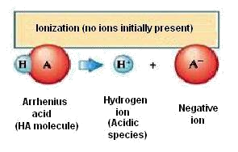
Arrhenius Concept of Acid and Bases
In the same way, HCl acts as Arrhenius acid in water and it converts to Cl- ion by transferring hydrogen ion to water.
When Arrhenius acids are in pure state (not in solution) they are covalent compounds, that is, they do not contain H⁺ ions. The ions are formed through an interaction between water and the acid when they are mixed. Ionization is the process in which individual positive and negative ions are produced from a molecular compound that is dissolved in solution.

Slide 12
Arrhenius Concept of Acid and Bases
STRENGTH OF ARRHENIUS ACIDS:
On the basis of ionization of acid , they can be classified into two types:
Strong acid: Those acids, which are completely ionized and give maximum number of proton (H+) in a solution are known as strong acid. The value of acid dissociation constant or strong acids (Ka) is very high.
Hence, the strength of acid is directly proportional to the acid
dissociation constant (Ka). Example: HCl, HNO₃, H₂SO₄ etc.
Weak acid: Those acids which are partially ionized i solution, like, acetic acid, hydrofluoric acid etc. are know as weak acids. The acid dissociation constant is less fo weak acids compared to strong acids.
Example: CH₃COOH, H₂CO₃, H₃PO₄ etc.

Slide 13
Arrhenius Concept of Acid and Bases
S.No. | Acid | Chemical formula | Ka
1 | Per chlorate | HClO4 | Very large
2 | Hydrochloric | HI | Very large
3 | Hydrophobic | HBr | Very large
4 | Hydrochloric | HCl | Very large
5 | Nitric | HNO₃ | Very large
6 | Sulfuric | H₂SO₄ | Very large
7 | Hydroponic ion | H₃O+ | 1.0
8 | Ionic | HIO₃ | 1.7 x 10⁻¹
9 | Oxalic | H₂C₂O₄ | 5.9 x 10⁻²
10 | Sulfurous | H₂SO₃ | 1.5 x 10⁻²
11 | Hydrogen sulfate ion | HSO₄ | 1.2 x 10⁻²
12 | PHOSPHORIC | H₃PO₄ | 7.5 x 10⁻³
13 | Citric | H₃C₆H₅O₇ | 7.1 x 10⁻⁴
14 | Nitrous | HNO₂ | 4.6 x 10⁻⁴
15 | Hydrofluoric | HF | 3.5 x 10⁻⁴
16 | Formic | HCOOH | 1.8 x 10⁻⁴
17 | Cenozoic | C₆H₅COOH | 6.5 x 10⁻⁴
18 | Acetic | CH₃COOH | 1.8 x 10⁻⁵
19 | Water | H₂O | 1.0 x 10⁻¹⁴

Slide 14
Arrhenius Concept of Acid and Bases
Arrhenius Base: An Arrhenius base is a hydroxide containing compound that produces hydroxide ions (OH- ions) in water. The basic species in Arrhenius theory is thus the hydroxide ion. For this reason Arrhenius bases are also called hydroxide bases.
Example:
NaOH(aq)→ Na⁺ + OH⁻ produces OH⁻ in water.
Some other examples of Arrhenius bases are KOH, Ca(OH)₂, NH₄OH etc.
KOH(aq)→ K⁺ + OH⁻
NH₄OH(aq)→ NH₄ + OH
+ -

Slide 15
Arrhenius Concept of Acid and Bases
STRENGTH OF ARRHENIUS BASES
Base | Formula | K_{b}
Ammonia | NH₃ | 4.75
Aniline | C₆H₅NH₂ | 9.37
Codeine | ^{C}18^{H}21^{O}3^{N} | 6.05
Diethylamine | (C₂H₅)₂NH | 4.51
Dimethylamine | (CH₂)NH | 3.23
Ethylamine | C₂H₅NH₂ | 3.36
Hydrazine | N₂H₄ | 5.77
Hyroxylamine | HONH₂ | 9.04
Methylamine | CH₃NH₂ | 3.38
Morphine | ^{C}17^{H}19^{O}3^{N} | 6.13
Piperidine | C₅H₅N | 2.88
Pyridine | C₅H₅N | 8.70
Quinoline | C₉H₇N | 9.20
Triethanlamine | C₆H₁₅O₃N | 6.24
Triethylamine | (C₂H₅)₃N | 3.28
Trimethylamine | (CH₃)₃N | 4.20

Slide 16
Strong Electrolytes
Strong Electrolytes:
“The electrolytes which ionise completely or near to completely are called strong
electrolytes.”
General Examples:
Strong Acids.
Strong Bases
Salts
Examples:
HCl, H₂SO₄, NaOH, KOH, NaCl, KBr, AgCl
4

Slide 17
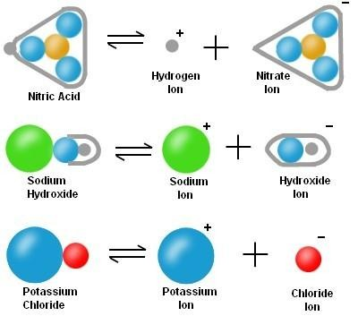
Examples of Strong Electrolytes
Strong electrolytes like salts are composed of oppositely charged ions. In solid state, these ions are held by strong electrostatic forces of attractions. When theses electrolytes are dissolved in water, the attraction forces between ions are highly weakened due to high dielectric constant of water.

Slide 18
Lewis Theory for Acid and Bases
Acid: A substance that can accept a pair of electrons to form a covalent bond.
The species that can be Lewis acid are
🞄 Cations such as H⁺, Fe²⁺, Al³⁺
🞄 molecules with incomplete octet central atom such as BF₃, BeCl₂
🞄 Molecules with central atom that can expand octet such as
PCl_{3 ,} SiF₄,
🞄 Molecules containing multiple bond such as CO₂, SO₂.
Base: A substance that can donate a pair of electrons to form a covalent bond.
The species that can be Lewis base are
🞄 anions such as OH⁻, CN⁻, Cl⁻
🞄 molecules with lone pairs electrons at the central atom such as H₂O, NH₃, ROH

Slide 19
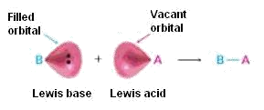
Lewis Theory for Acid and Bases
Lewis Acid: A Lewis acid is an electron pair acceptor. The accepted electron pair is shared between the acid and the base in the covalent bond. Thus, Lewis definition of acidity includes many species in addition to H+.
For example, various metal cations, such as Mg2+ and metal
have
compounds such as AlCl3 are Lewis acids because they
vacant valence orbitals and can accept electron bases.
pairs from Lewis

Slide 20
Lewis Theory for Acid and Bases
Type of Lewis Acids:
Molecules having a central atom with incomplete octet. E.g. BF3, AlCl3, FeCl3.
Simple cations. E.g. Ag+, Cu+, Fe3+.
Molecules having central atoms with empty d- orbitals. E.g. SiF4, PCl5.
Molecules containing a multiple bond between two atoms of different electro negativities.
E.g. CO₂,SO₂.

Slide 21
Lewis Theory for Acid and Bases
Lewis Base: The substance that donates the electron pair. The donated electron pair is shared between the acid and the base in the covalent bond.
In a more general sense, most oxygen and nitrogen containing organic compounds can act as Lewis bases because they have pairs of electrons.
TYPES OF LEWISBASES
Neutral molecules like NH_{3,} R-NH₂, etc.
All negative ions like F-, Cl-, Br-, I-, OH-, etc.

